Slide 1

Parallel applications of python
By Philipp tiso
We will use repl.it as our IDE, create an account if you haven't already (use your google account).
Python Logo: https://www.kissclipart.com/python-programming-logo-clipart-python-programming-ufxms6/

Slide 2
What is parallelism?
The notion that multiple operations can be completed at what is perceived to be the same time (though this is not always the case)
Programs may need to achieve multiple things at similar times, hence we introduce the concept of parallelism

Slide 3
How do programs actually run?
When we write code, we are detailing a set of instructions that the CPU/GUP ought to execute
When our program is compiled into an executable, the code will be compiled such that it can be executed later on
When a program is launched, we refer to it as a process
Simply: A process is a program which is actively running on the machine

Slide 4
There are two ways to achieve concurrency
Multi-Processing
The process constructs a clone of itself and branches
Processes use shared memory to communicate
Multi-Threading
A thread is constructed within the host process and executes once instructed to do so

Slide 5
Process
A process can contain numerous threads (always has one main thread)
The diagram below depicts a single process with 3 individual threads
When the original process dies, the other processes will keep running
For processes to communicate we need to facilitate inter-process communication, which would require shared memory
Code
Data
File
Register
Register
Register
Stack
Stack
Stack

Slide 6
Threads
Threads are contained within processes, hence they can perform intra-process communication (multiple threads communicate within the same process)
Threads share variables with the parent process, hence we don’t need any explicitly shared memory, since the nature of threads makes this redundant

Slide 7
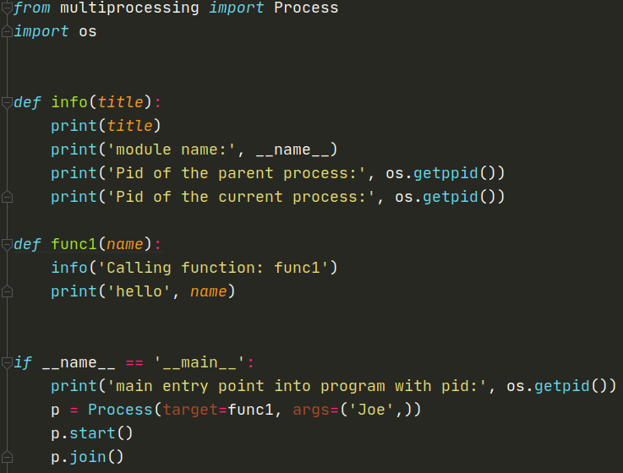
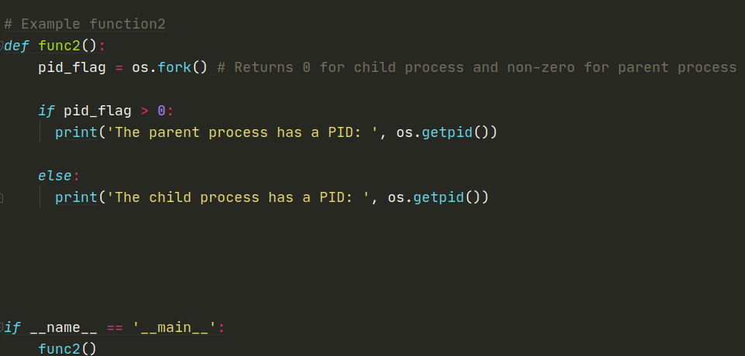
Multi-Processing in python
We will be using the multiprocessing library provided by python
import multiprocessing
It is conceivable that we don’t want processes to run after our program ends
We will use the join() function provided by the multiprocessing package

Slide 8
Open exercise
Try to make use of processes for experimental purposes for around 5-10 minutes
What are some problems that may arise when creating multiple processes?
Think about the concurrent nature of what we are doing
Consider the implications of shared memory, what are the limitations associated with it

Slide 9
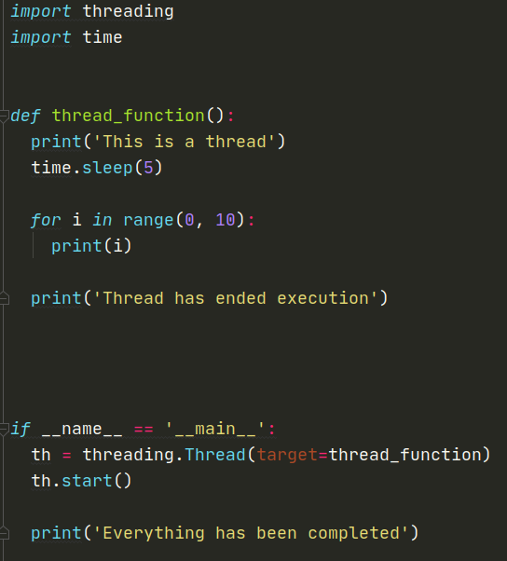
Multi-Threading in Python
Multithreading works similarly to multiprocessing in terms of syntax
Threading allows us to access variables shared by all threads (since they are contained within the same process)
Threads will run asynchronously with respect to the main thread
What would the output of this code be?

Slide 10
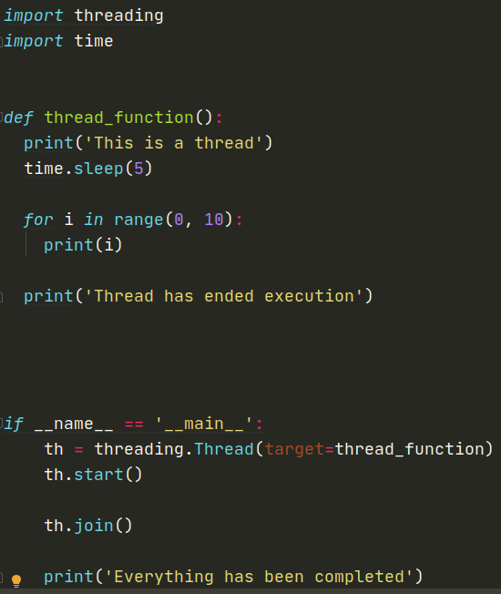
The Join() method
As we saw before, the execution is completely out of sync, we need to fix this somehow
The join() method will tell our program to halt until the tread execution has concluded

Slide 11
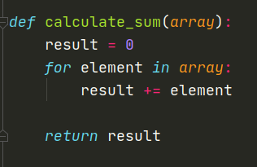
Array summation
Let us assume that we wish to construct a script which sums up all the elements in an array
Wouldn't it be convenient if we were able to delegate various sections of this homogeneous task?
Yes, obviously that would be great since we can get some speedup

Slide 12
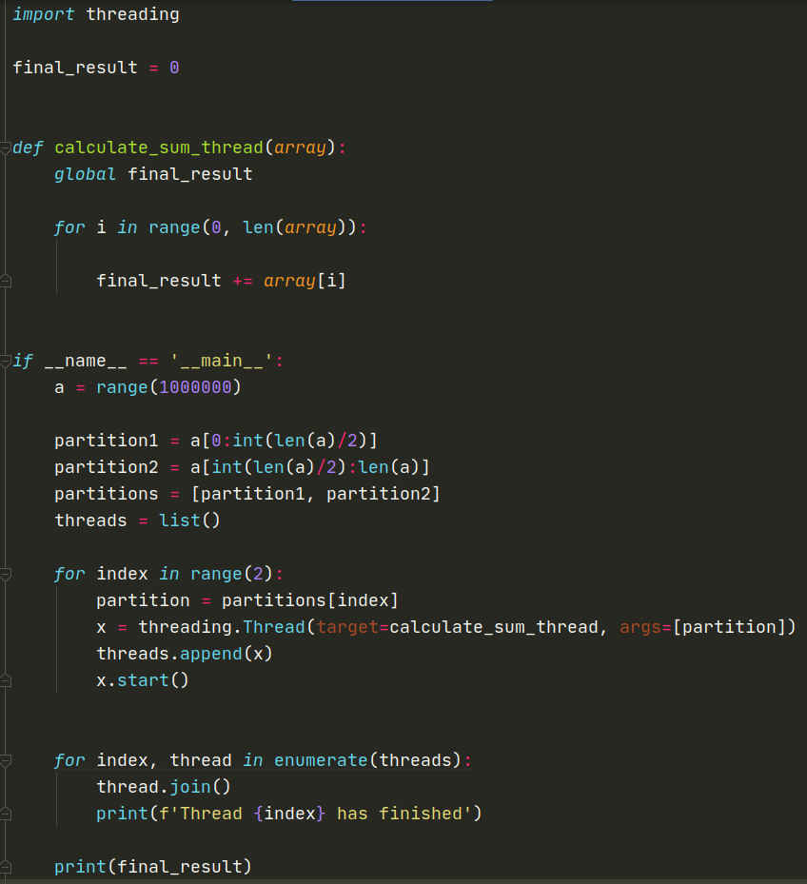

Application of Concurrency
Lets say we thread some existing program which calculates the sum of all elements in an array
$\sum_{k=0}^{{10}^{6}−1}{k}=499999500000$
Remember, range() excludes the stop value
Are there any potential issues with this?
Lets run it and see for ourselves
What if we picked a smaller upper bound, say $10$?
What do you notice?
What can you deduce from your findings?

Slide 13

Race conditions
As we saw from the sample code, we keep getting different numbers, but why is that?
Processes can’t just hog the CPU, eventually they will be ejected and requeued, the same is when threads are executing (one may get suspended)
This can pose issues when writing data into registers, since $thread n$ may overwrite the current register value before $thread x$ can update it

Slide 14
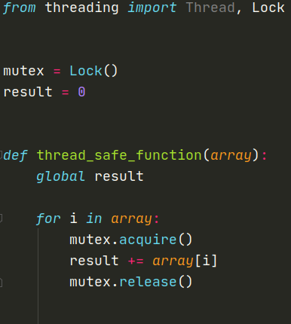
How do we fix this?
Utilize mutex (locking mechanism) and identify critical sections which should execute atomically
The mutex is very simple, think of it as a lock.
A mutex is a key that a thread acquires to enter some critical section
Once the thread is done with the section, it releases the key so others can use it

Slide 15
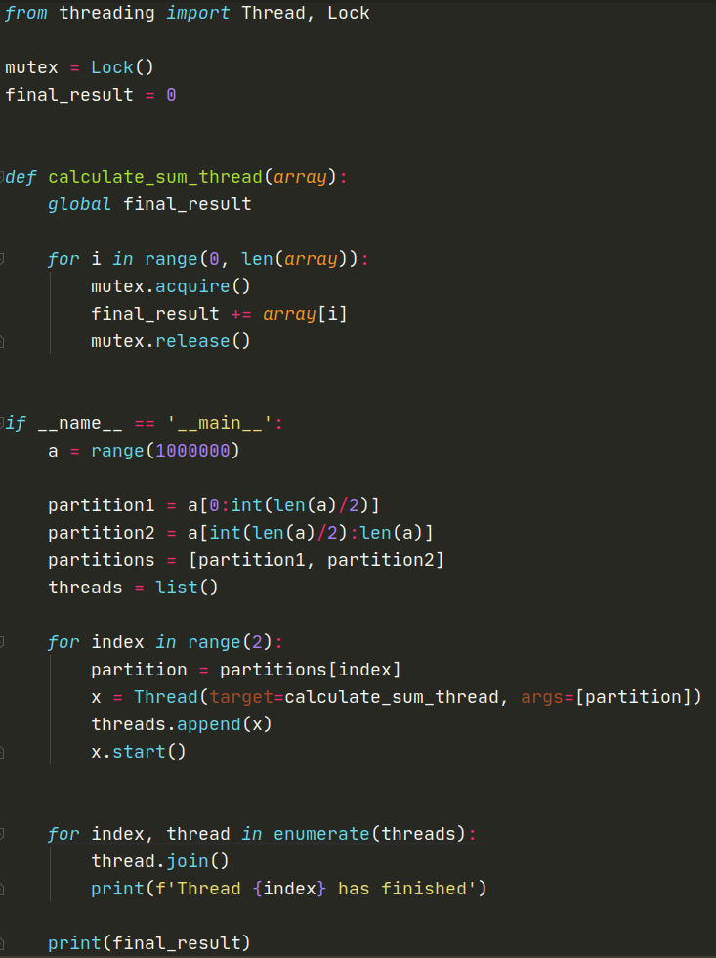
Enough talk
Try implementing the solution that we have discussed using the mutex
You may need to import the Lock class if you have not done so already
This should take 5 minutes at most

Slide 16

But can we do better?
Yes, what we have done is incredibly inefficient, for an array of size $n$, we will need to lock & unlock the mutex $n$ times
This may not seem like a lot, but once we work with large datasets this becomes very slow
But there is a way where the mutex is only used twice over the course of the entire program
You have 10 minutes to try and find more optimal solution, with respect to what we have proposed up until this point

Slide 17
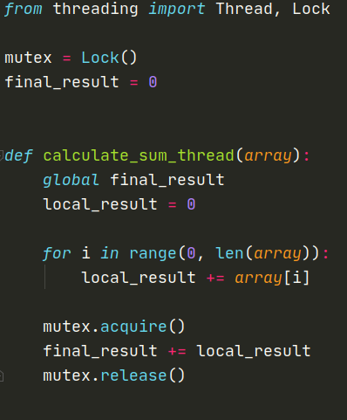
Solution
We make use of a local variable which is not shared between threads
Every thread has its own instance of local_result
We only write to the global variable (final_result) once we have completed the summation locally

Slide 18
conclusion
We have looked at some threading an multi-processing, note that we have but looked at the surface of this, concurrency becomes rather complex when we look at more optimizations and implementations
Take some time and write some scripts which make use of threads
You are more than welcome to demo the scripts to your peer

